Slide 1


Developing automatic text-mining pipeline to extract glycosylation information from literature.
-Vijay Shanker (Udel)
-Karen Ross (GU)
-Rahi Navelkar (GWU)

Slide 2
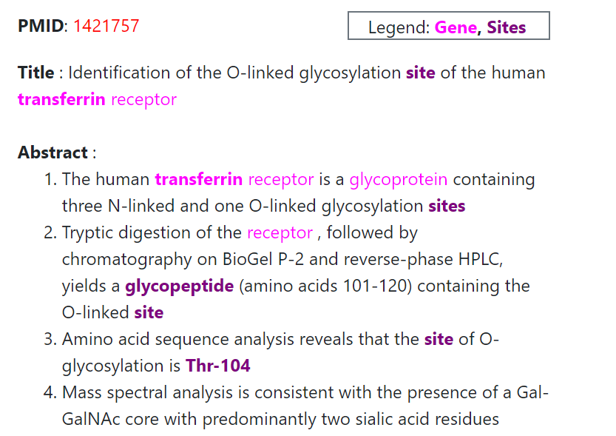
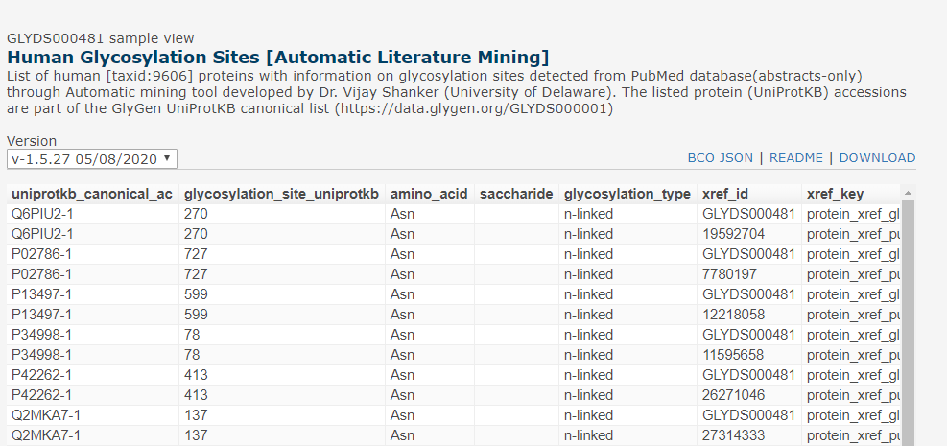
Year 1:
Assessment
Assessment of papers from UniCarbKB for protein+site+glycan (currently captured in GlyGen.)
Refining the tool based on the provided false positives and false positives
Feedback and Refine
Development
Performing automated and manual QC and integration of passed rows (annotations) into GlyGen.
Development of detection method for protein and glyco-site from literature (abstracts only)
Verification and Integration
Detection and Normalization
https://data.glygen.org/GLYDS000481
Running the developed tool on abstracts (1st round) and normalization of the detected protein to UniProtKB accession using PubTator.
Fig 2:Integration of the detected and verified annotations in GlyGen.
Fig1:Detection of protein and site.

Slide 3

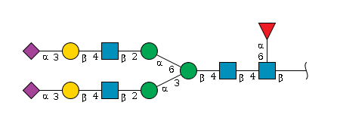

Year 2: Goals
Detection of additional entities from literature
Capture additional information such as - Disease
- Expression system
- Function, etc
Expanding to full-length papers.
Detection of Glycan description strings
Inclusion of PMC/Medline papers (open access set) and detection from figure captions.
Generating confidence scores for annotations
Capture strings that may describe the glycan and if available assign to a site.
Assisting the automatic verification of data.
Creating star-rating system to mark high-confidence vs low-confidence annotations
Addition of the protein name to automatically check the normalization of protein.

