Slide 1
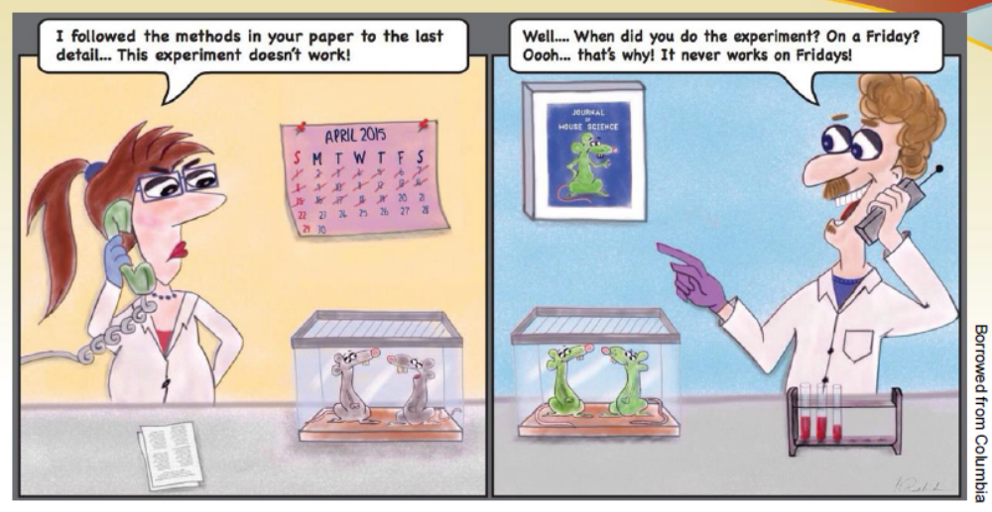
Rigor, Reproducibility, and Transparency in Research
Ryan Weiss, Ph.D.
Glycoscience Journal Club
August 30, 2021
Notes:
Today we are going to discuss Rigor, Reproducibility, and Transparency in Research. These topics are of huge importance for all of us to perform robust scientific research. All terms are interdependent. Today’s session is an opportunity for a discussion about these topics.

Slide 2
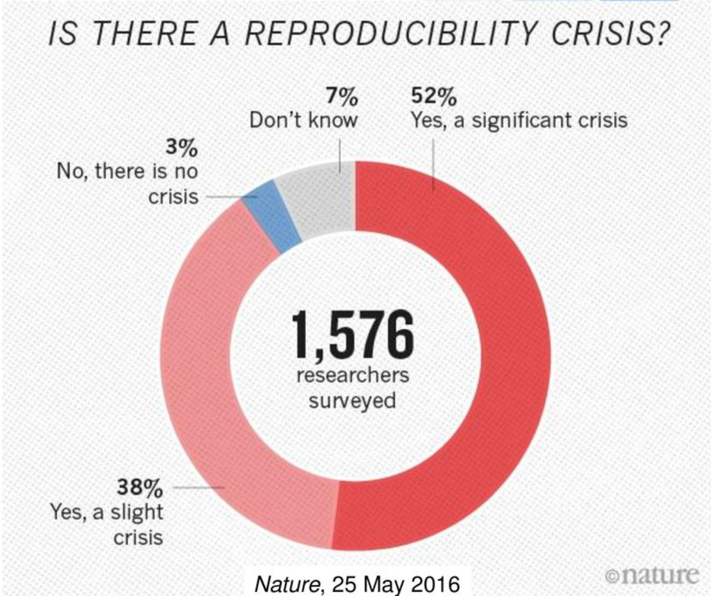
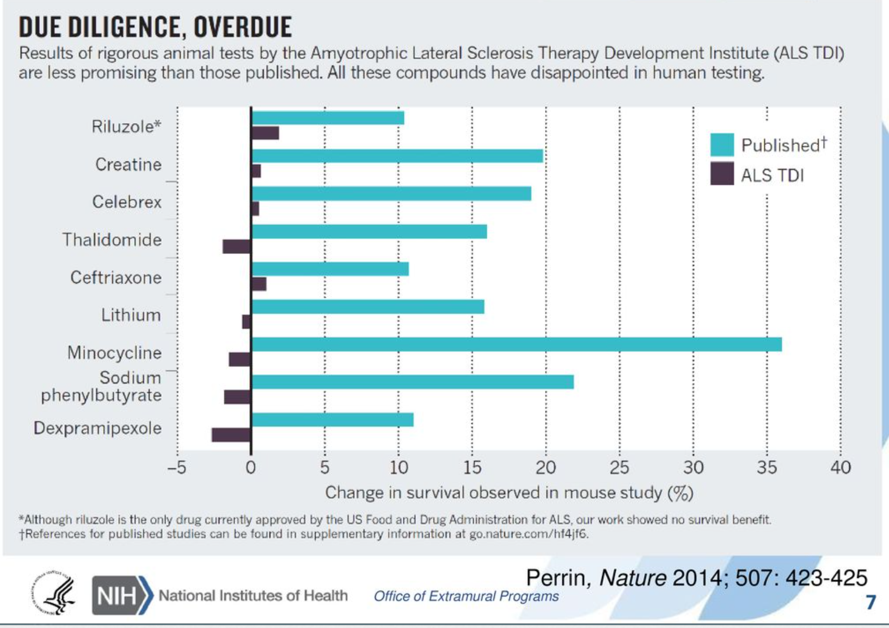
Why focus on reproducibility?
Notes:
Concern about the reproducibility of scientific research has been steadily rising recently with reports that the results of experiments in numerous domains of science could not be replicated

Slide 3
Why focus on reproducibility?
Challenges:
Science is viewed as “self-correcting”
Poor Training
Current publication practices
Hyper-competitive environment
Notes:
Science is taken at face value as self-correcting, while this is not necessarily the case
Poor training leads to inadequate experimental design and reporting practices
Difficulty publishing negative results; overemphasis on big picture/exciting
Low funding rates; grants/tenure based on “high-impact” pubs

Slide 4
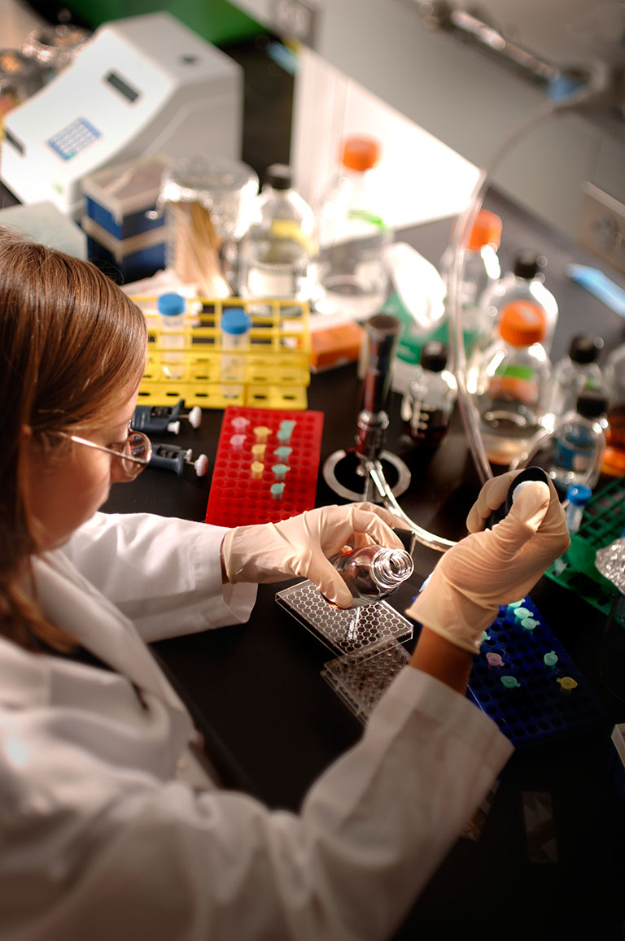
What is Scientific Rigor?
Notes:
Rigor: The strict application of the scientific method to ensure robust and unbiased experimental design, methodology, analysis, interpretation and reporting of results

Slide 5
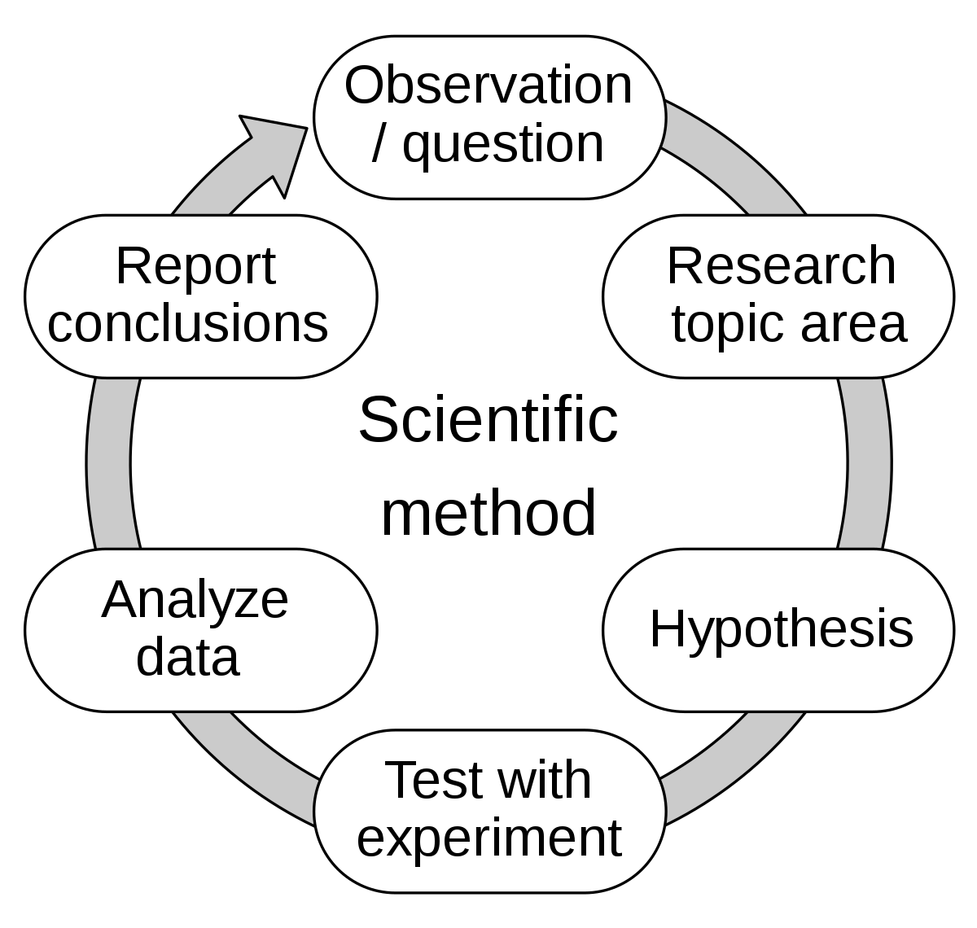
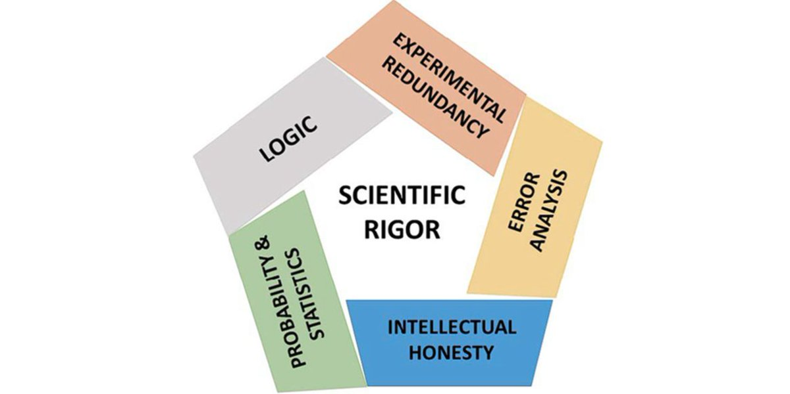
What is Scientific Rigor?
Rigor: The strict application of the scientific method to ensure robust and unbiased experimental design, methodology, analysis, interpretation and reporting of results
Notes:
This is the goal for our science as well as our grant proposals and experimental design

Slide 6
What is Scientific Rigor?
Rigor: The strict application of the scientific method to ensure robust and unbiased experimental design, methodology, analysis, interpretation and reporting of results
QUESTION:
What factors affect scientific rigor?
Notes:
This is the goal for our science as well as our grant proposals and experimental design

Slide 7
What is Scientific Rigor?
Rigor: The strict application of the scientific method to ensure robust and unbiased experimental design, methodology, analysis, interpretation and reporting of results
Experimental Design
Minimizing unintended bias
Data Analysis
Transparent Reporting
Reproducibility
Do the conclusions align with the results?
QUESTION:
What factors affect scientific rigor?

Slide 8
What is Scientific Rigor?
Rigor: The strict application of the scientific method to ensure robust and unbiased experimental design, methodology, analysis, interpretation and reporting of results
Experimental Design
Minimizing unintended bias
Data Analysis
Transparent Reporting
Reproducibility
Do the conclusions align with the results?
GROUP DISCUSSION:
What are features of experimental design that increase the likelihood of robust and unbiased results?
Notes:
Answers: Standards, sample size, randomization, blinding, replicates, stats, inclusion/exclusion criteria, sex (animal studies)

Slide 9
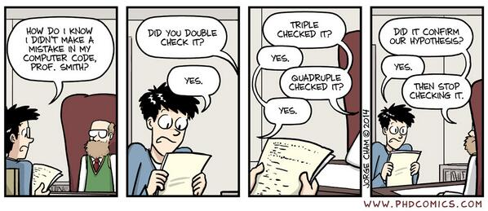
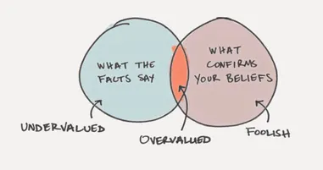
What is Bias in Research?
Notes:
We all come to the bench with some sort of bias…how do we minimize this?
What is bias in research?
When you think of bias in an experiment, what comes to mind?
Poor experimental/study design
data collection errors
doing experiment with expected result in mind
poor training/technique
improper statistical test or presentation of the data

Slide 10
What is Bias in Research?
What are examples of bias in research?
Notes:
We all come to the bench with some sort of bias…how do we minimize this?
What is bias in research?
When you think of bias in an experiment, what comes to mind?
Poor experimental/study design
data collection errors
doing experiment with expected result in mind
poor training/technique
improper statistical test or presentation of the data

Slide 11
What is Bias in Research?
Bias: prejudice in favor of or against one idea, thing, person, or group compared with another, usually considered to be unfair
Bias in research: when systematic error is introduced into sampling or testing by selecting or encouraging one outcome or answer over others

Slide 12
What is Bias in Research?
Bias: prejudice in favor of or against one idea, thing, person, or group compared with another, usually considered to be unfair
Bias in research: when systematic error is introduced into sampling or testing by selecting or encouraging one outcome or answer over others
GROUP DISCUSSION:
What is an example of an unavoidable bias?
Avoidable bias?
Intentionally introduced bias?
Notes:
Unavoidable: inherent experimental error for a given technique/method (cell counter/balance is only accurate to a specific decimal place)
Avoidable: Not taking into account all possible variables (lack of controls), faulty instrument/equipment for data collection resulting in error
Introduced: improper sample exclusion (omission bias), incorrect statistics, reporting bias (positive research vs. null hypothesis results)

Slide 13
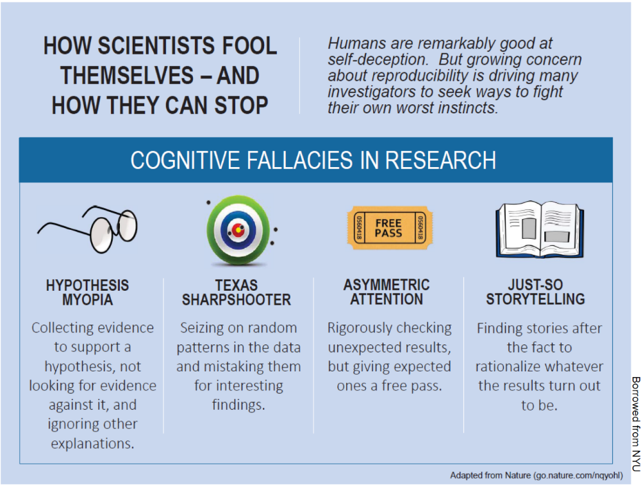
What is Bias in Research?
Bias: prejudice in favor of or against one idea, thing, person, or group compared with another, usually considered to be unfair
Notes:
Do you think there is a component of laboratory and research culture that must be considered when addressing reproducibility and rigor in research?
How do you think bias might affect what is documented in a protocol, or detailed in a materials and methods section?

Slide 14
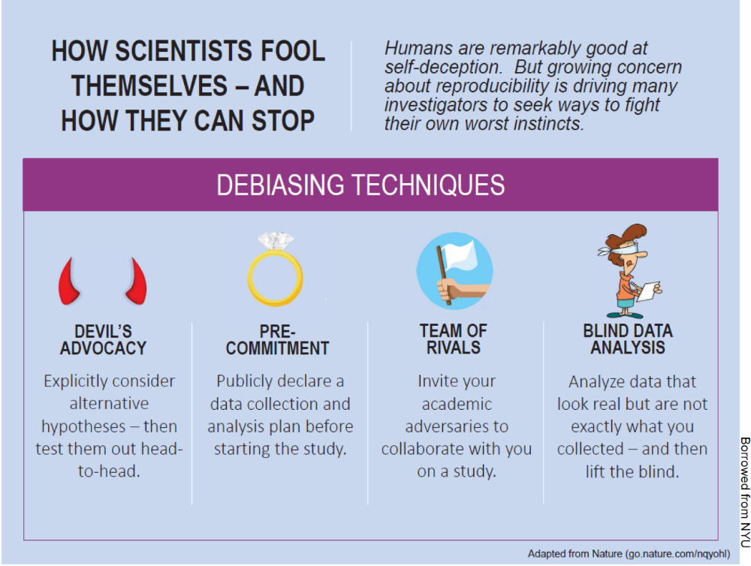
What is Bias in Research?
Bias: prejudice in favor of or against one idea, thing, person, or group compared with another, usually considered to be unfair

Slide 15
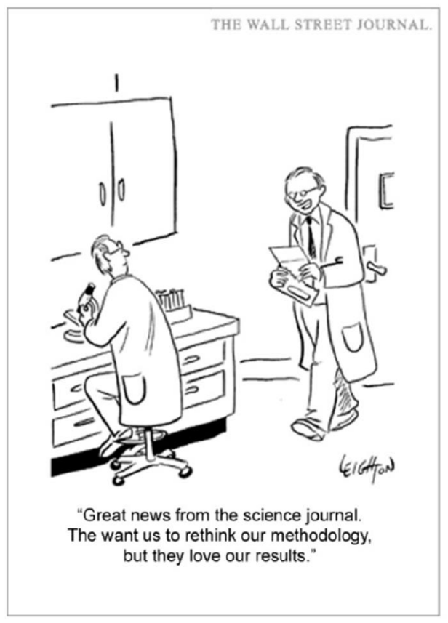
What is Bias in Research?
Bias: prejudice in favor of or against one idea, thing, person, or group compared with another, usually considered to be unfair
Blinding and Randomization
Confirmation Bias
Notes:
Have you ever felt pressure, either from your PI or reviews of a submitted paper, to obtain a specific result?
Blinding and randomization – have you done this before in your own experiments? Ask your friends to help.
From video on blinding, if the results were what they hoped/expected, would they have explored further? CONFIRMATION BIAS

Slide 16
Types of Scientific Research
Hypothesis-driven Research
Discovery-based Research
Notes:
What do I mean by hypothesis and discovery-based research?
Hypothesis (scientific method, starts with a question/prediction to test) | Discovery-based (unbaised screen or experiment, lacking former info/knowledge on question)
Discovery-based = Hypothesis-generating research

Slide 17
Types of Scientific Research
Hypothesis-driven Research
Discovery-based Research
Notes:
Hypothesis (scientific method, starts with a question/prediction to test) | Discovery-based (unbaised screen or experiment, lacking former info/knowledge on question)
Discovery-based = Hypothesis-generating research

Slide 18
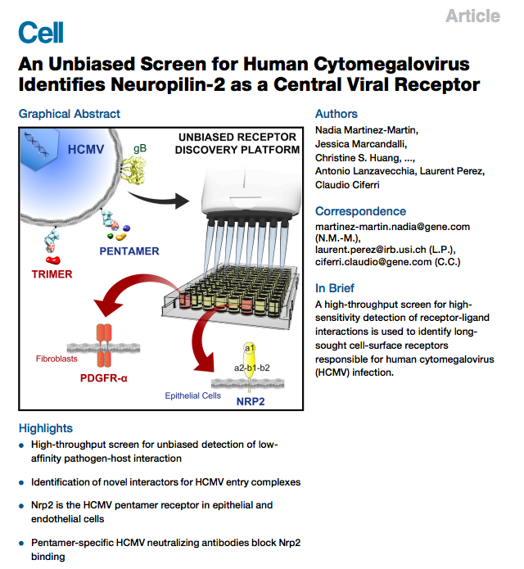
Types of Scientific Research
Hypothesis-driven Research
Discovery-based Research
Notes:
Advantages/Disadvantages –
Hypothesis-driven: hypothesis could be wrong/be the opposite/alternative, may be difficult to set up experiment to test hypothesis, how exciting is the question?, incremental
Discovery-based: fishing expedition, no hypothesis initially, creative/innovative

Slide 19
Types of Scientific Research
Hypothesis-driven Research
Discovery-based Research
GROUP DISCUSSION:
Advantages/Disadvantages?
Notes:
Advantages/Disadvantages –
Hypothesis-driven: hypothesis could be wrong/be the opposite/alternative, may be difficult to set up experiment to test hypothesis, how exciting is the question?, incremental
Discovery-based: fishing expedition, no hypothesis initially, creative/innovative

Slide 20
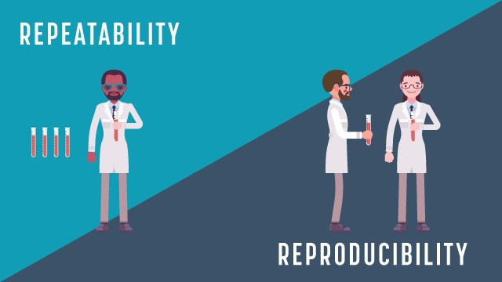
What is Reproducibility in Research?

Slide 21
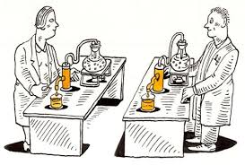
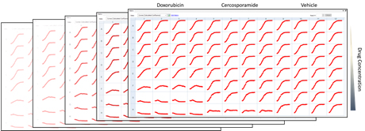
What is Reproducibility in Research?
Repeatability: measures the variation in measurements taken by a single instrument or person under the same conditions
Reproducibility: The ability of a researcher to duplicate the results of a prior study using the same materials as were used by the original investigator

Slide 22
What is Reproducibility in Research?
Repeatability: measures the variation in measurements taken by a single instrument or person under the same conditions
Reproducibility: The ability of a researcher to duplicate the results of a prior study using the same materials as were used by the original investigator
GROUP DISCUSSION:
What factors can affect reproducibility in research?

Slide 23
What is Reproducibility in Research?
Repeatability: measures the variation in measurements taken by a single instrument or person under the same conditions
Reproducibility: The ability of a researcher to duplicate the results of a prior study using the same materials as were used by the original investigator
GROUP DISCUSSION:
What factors can affect reproducibility in research?
  Research Misconduct
    Data manipulation
    Fabrication/Falsification
    Plagiarism
  Honest error
  Improper statistical methods
  Lack of authentication of resources
  Lack of transparency

Slide 24
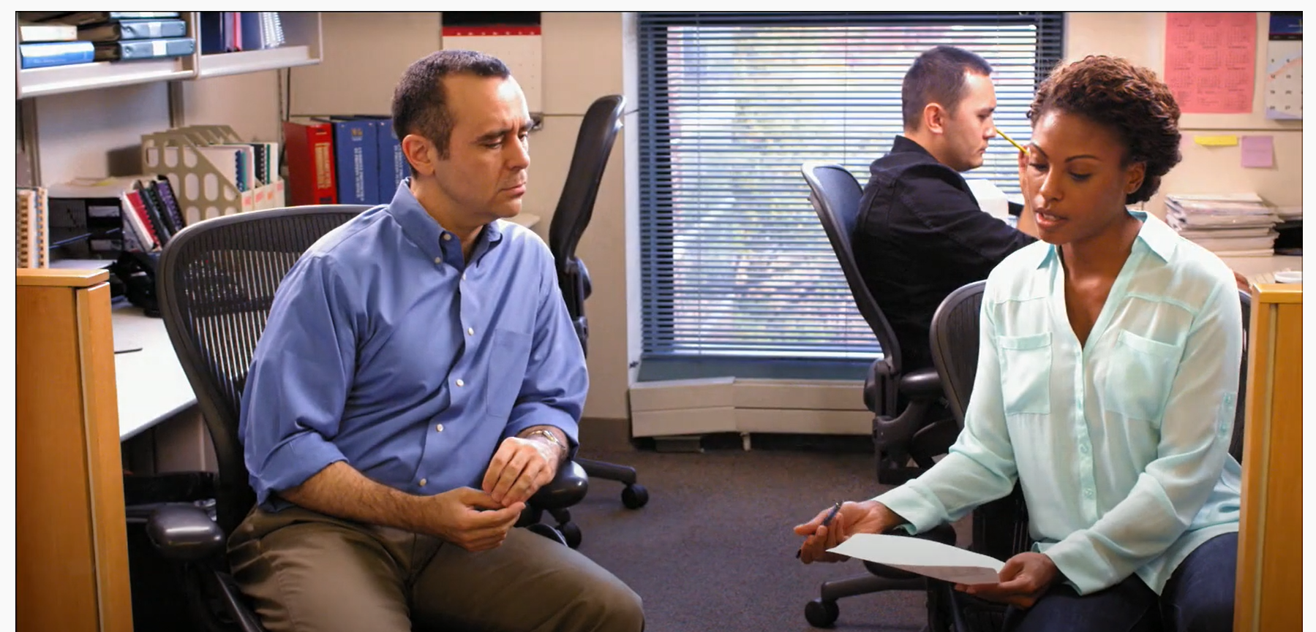
Biological vs. Technical Replicates
Biological Replicates: parallel measurements of biologically distinct samples that capture random biological variation
Technical Replicates: repeated measurements of the same sample that represent independent measures of the random noise associated with protocols or equipment
Notes:
How does it work with cells? Mice? Is one type of replicate “better” than the other?

Slide 25
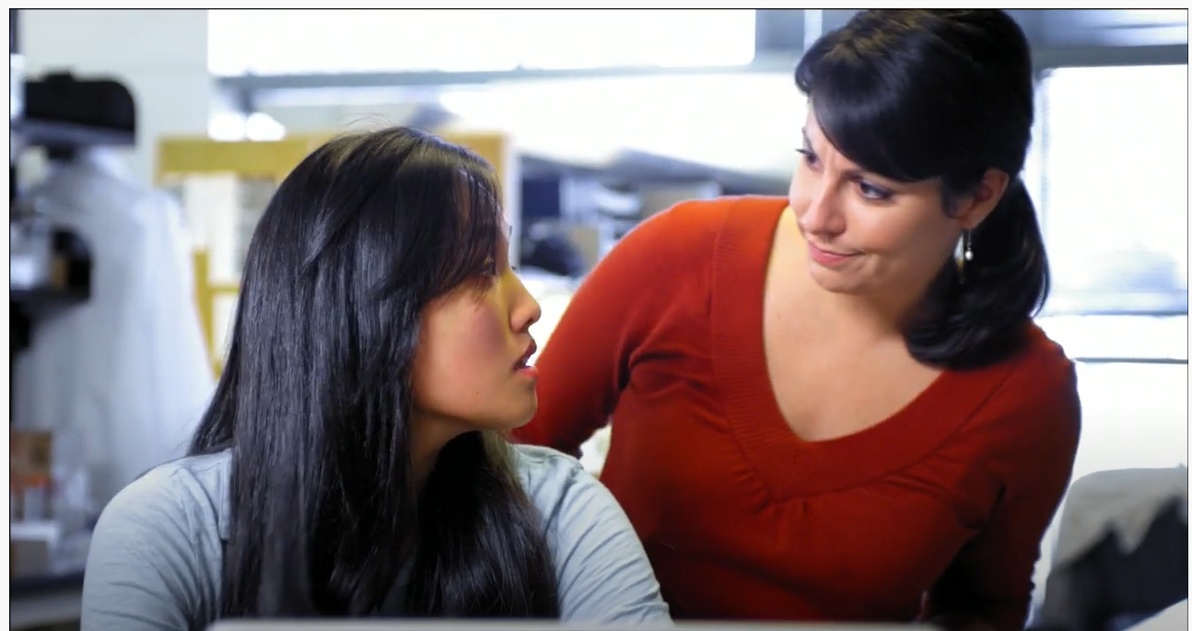
What is transparency in research?
Transparency: Approach to sharing of knowledge and data that is as open, accessible and unbiased as possible to enable broad dissemination, understanding and utility.
Notes:
Overall thoughts on short video? Could this have been handled any differently?

Slide 26
What is transparency in research?
Transparency: Approach to sharing of knowledge and data that is as open, accessible and unbiased as possible to enable broad dissemination, understanding and utility.
  Reporting experimental details so that others can reproduce the results
  Sharing of raw data sets and programs
  Data Archiving
  Device Archiving

Slide 27
What is transparency in research?
Transparency: Approach to sharing of knowledge and data that is as open, accessible and unbiased as possible to enable broad dissemination, understanding and utility.
  Reporting experimental details so that others can reproduce the results
  Sharing of raw data sets and programs
  Data Archiving
  Device Archiving
  QUESTIONS:
  Do you think most people knowingly display a lack of transparency in published papers?
  Do journals have a role in determining transparency?

Slide 28
Resources
ASBMB Trainings/Resources
  http://jbcresources.asbmb.org/further-reading
NIH Rigor and Reproducibility Training Modules
Cell Line Authentication Training (Global Biological Standards Institute)
Let's Experiment: A Guide for Scientists Working at the Bench (iBiology)
“What exactly is ‘N’ in cell culture and animal experiments?” (Lazic, et al. PLOS Biology 2018)
Society for Neuroscience Rigor and Reproducibility Training Webinars

